Slide 1




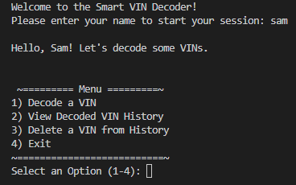
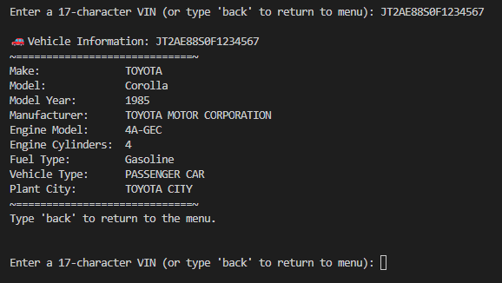

SMART VIN DECODER
SAM
MILLER
GIT REPO
ENTER A VIN. INSTANTLY DECODE VEHICLE DETAILS, HISTORY, AND SPECS.
PROJECT OVERVIEW
PROJECT’S FUTURE
Project Idea:
A command-line tool that decodes input VINs to show vehicle make, model, year, and more.
Sources Used
NHTSA API
Python Docs
Roadblock & Fixes
Problem: I needed to match decoded VINs from vin_list with the correct model/make from the vin_history dictionary.
Issue: I wasn’t sure how to use the VIN as a key and print both the model and VIN together.
Fix: I used a for loop with format() to cleanly print each VIN and its corresponding model from the dictionary.
Next Steps
Add GUI
Export CSV
Expand support for older/classic VINs
What I learned
How to access and use a public API
How to extract and display specific information
Application of resources

